Slide 1


Global Bootcamp – Houston Edition

Slide 2
From Reinforcement Learning to Deep Reinforcement Learning
Lucia Botiquin

Slide 3
Outline:
Machine Learning
Types of Learning
Supervised Learning and Deep Learning
Unsupervised learning
Reinforcement Learning (RL)
Applications of Reinforcement Learning
Elements of Reinforcement Learning
Q-Learning
Tutorial
Deep Reinforcement Learning for ATARI
Deep Reinforcement Learning for StarCraft II
Notes:
Update:

Slide 4
Machine Learning vs Programming
Traditional Programming
Machine Learning
Put a set of rules into a program
Getting computers to program themselves
Data
Data
Computer
Output
Computer
Program
Program
Output
Training

Slide 5
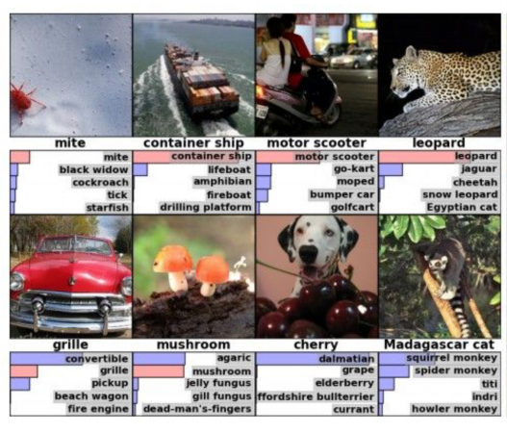
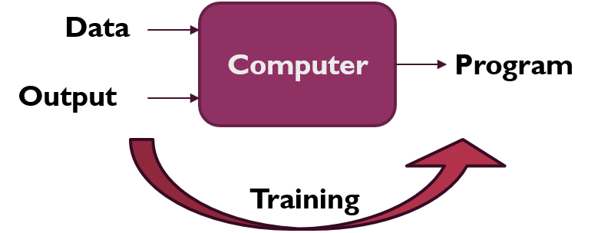
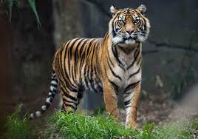
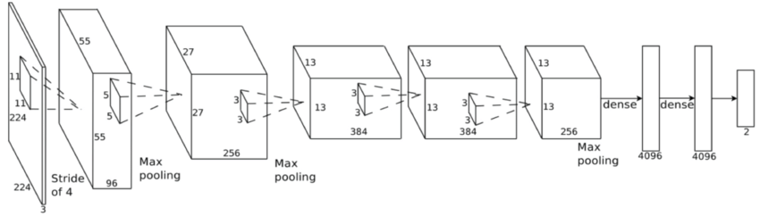
Types of Learning (1) Supervised Learning
Supervised learning is learning from a training set of labeled examples provided by a knowledgeable external supervisor.
Suitable for classification or regression.
We can view those algorithms as a function approximation
Deep Learning
Tiger
Convolutional Neural Network
Notes:
Find a better resolution of the picture
ImageNet data

Slide 6
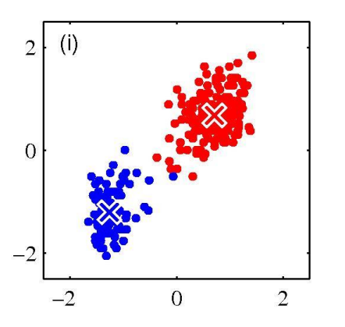
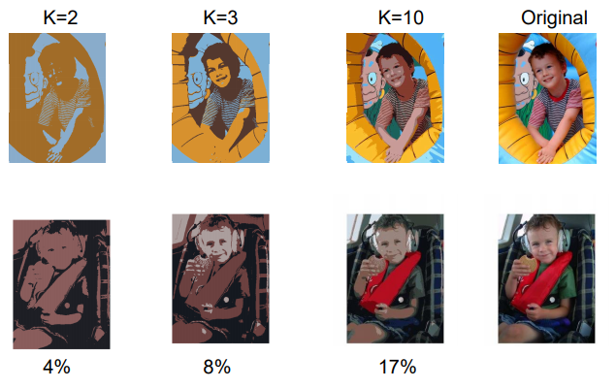
Types of Learning (2) Unsupervised Learning
Useful for finding structure hidden in collections of unlabeled data.
K-means clustering
K-means for Segmentation
Notes:
The terms supervised learning and unsupervised learning would seem to exhaustively classify machine learning paradigms, but they do not.

Slide 7
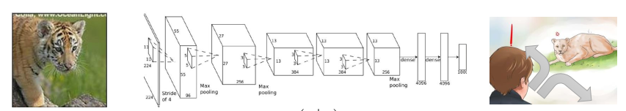

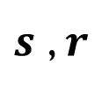



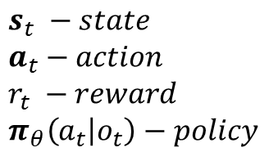

Types of Learning (3) Reinforcement Learning
$$s_{t} −state$$
$$a_{t}−action$$
$$r_{t} −reward$$
$$π_{θ}\left(a_{t} | o_{t}\right)−policy$$
$$π_{θ}\left(a | s\right)$$
$s$ , $r$
$$a$$
Environment
Agent
$$P\left(s_{t+1}, r_{t}\right|s_{t},a_{t})$$
State, Reward
Action
$s_{t}$ , $r_{t}$
$$a_{t}$$
Environment
Notes:
Reinforcement learning is learning what to do—how to map situations to actions—so as to maximize a numerical reward signal.
The learner is not told which actions to take, but instead must discover which actions yield the most reward by trying them. In the most interesting and challenging cases, actions may affect not only the immediate reward but also the next situation and, through that, all subsequent rewards. These two characteristics—trial-and-error search and delayed reward—are the two most important distinguishing features of reinforcement learning.
Challenge: trade-off between exploration and exploitation.

Slide 8
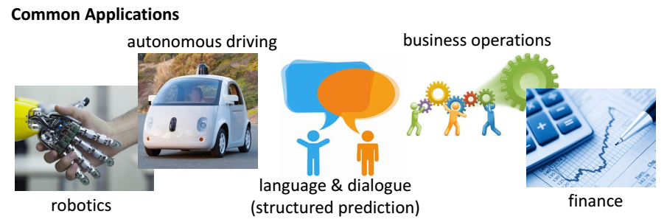
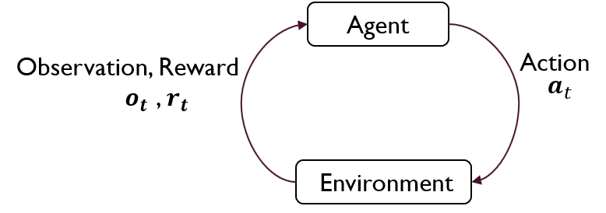
RL Applications:

Slide 9
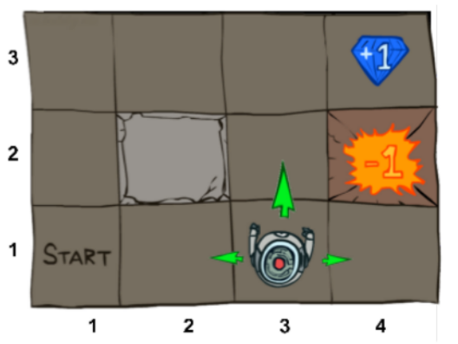
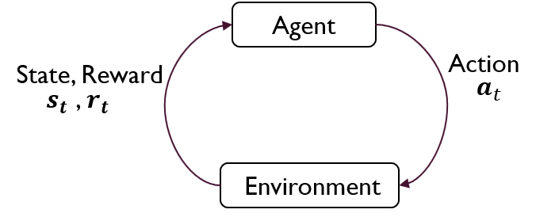
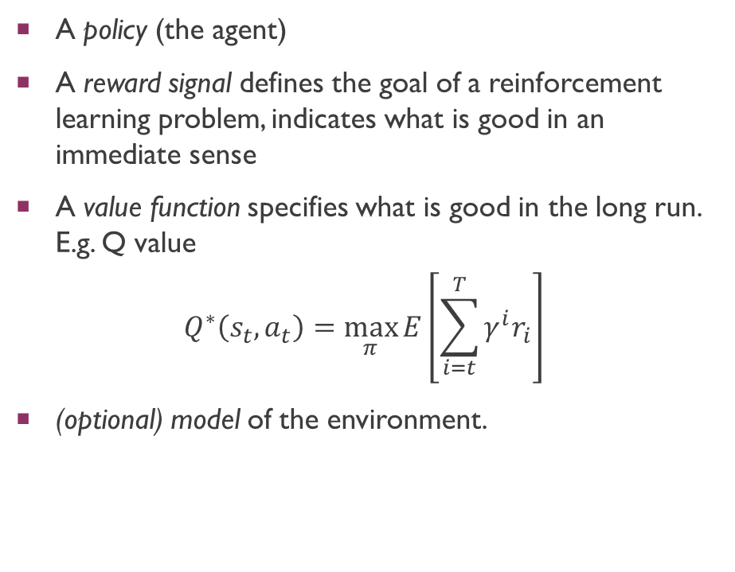
Elements of Reinforcement Learning
A policy (the agent)
A reward signal defines the goal of a reinforcement learning problem, indicates what is good in an immediate sense
A value function specifies what is good in the long run. E.g. Q value
$$Q^{∗}\left(s_{t}, a_{t}\right)=\max_{π}{E\left[\sum_{i=t}^{T}{γ^{i}r_{i}}\right]}$$
(optional) model of the environment.
Notes:
Beyond the agent and the environment, one can identify four main subelements of a reinforcement learning system: a policy, a reward signal, a value function, and, optionally, a model of the environment.
1) A policy defines the learning agent’s way of behaving at a given time. Roughly speaking, a policy is a mapping from perceived states of the environment to actions to be taken when in those states. It corresponds to what in psychology would be called a set of stimulus–response rules or associations. In some cases the policy may be a simple function or lookup table, whereas in others it may involve extensive computation such as a search process. The policy is the core of a reinforcement learning agent in the sense that it alone is su!cient to determine behavior. In general, policies may be stochastic, specifying probabilities for each action. A reward signal defines the goal of a reinforcement learning problem. On each time step, the environment sends to the reinforcement learning agent a single number called the reward. The agent’s sole objective is to maximize the total reward it receives over the long run. The reward signal thus defines what are the good and bad events for the agent. In a biological system, we might think of rewards as analogous to the experiences of pleasure or pain. They are the immediate and defining features of the problem faced by the agent. The reward signal is the primary basis for altering the policy; if an action selected by the policy is followed by low reward, then the policy may be changed to select some other action in that situation in the future. In general, reward signals may be stochastic functions of the state of the environment and the actions taken. Whereas the reward signal indicates what is good in an immediate sense, a value function specifies what is good in the long run. Roughly speaking, the value of a state is the total amount of reward an agent can expect to accumulate over the future, starting from that state. Whereas rewards determine the immediate, intrinsic desirability of environmental states, values indicate the long-term desirability of states after taking into account the states that are likely to follow and the rewards available in those states. For example, a state might always yield a low immediate reward but still have a high value because it is regularly followed by other states that yield high rewards. Or the reverse could be true. To make a human analogy, rewards are somewhat like pleasure (if high) and pain (if low), whereas values correspond to a more refined and farsighted judgment of how pleased or displeased we are that our environment is in a particular state. Rewards are in a sense primary, whereas values, as predictions of rewards, are secondary. Without rewards there could be no values, and the only purpose of estimating values is to achieve more reward. Nevertheless, it is values with which we are most concerned when making and evaluating decisions. Action choices are made based on value judgments. We seek actions that bring about states of highest value, not highest reward, because these actions obtain the greatest amount of reward for us over the long run. Unfortunately, it is much harder to determine values than it is to determine rewards. Rewards are basically given directly by the environment, but values must be estimated and re-estimated from the sequences of observations an agent makes over its entire lifetime. In fact, the most important component of almost all reinforcement learning algorithms we consider is a method for e!ciently estimating values. The central role of value estimation is arguably the most important thing that has been learned about reinforcement learning over the last six decades. The fourth and final element of some reinforcement learning systems is a model of the environment. This is something that mimics the behavior of the environment, or more generally, that allows inferences to be made about how the environment will behave. For example, given a state and action, the model might predict the resultant next state and next reward. Models are used for planning, by which we mean any way of deciding on a course of action by considering possible future situations before they are actually experienced. Methods for solving reinforcement learning problems that use models and planning are called model-based methods, as opposed to simpler model-free methods that are explicitly trial-and-error learners—viewed as almost the opposite of planning. In Chapter 8 we explore reinforcement learning systems that simultaneously learn by trial and error, learn a model of the environment, and use the model for planning. Modern reinforcement learning spans the spectrum from low-level, trial-and-error learning to high-level, deliberative planning

Slide 10
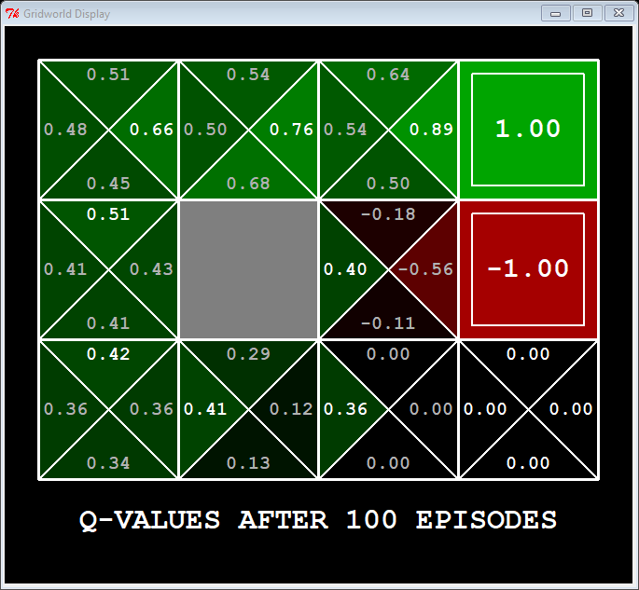
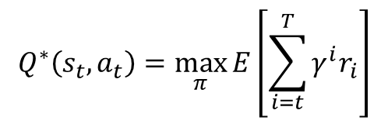
Q-Learning
$$Q^{∗}\left(s_{t}, a_{t}\right)=\max_{π}{E\left[\sum_{i=t}^{T}{γ^{i}r_{i}}\right]}$$
Notes:
While reinforcement learning agents have achieved some successes in a variety of domains, ,their applicability has previously been limited to domains in which useful features can be handcrafted, or to domains with fully observed, low-dimensional state spaces.

Slide 11
DEEP Reinforcement learning
Integrates deep learning to approximate the value function.
For example in Q-Learning, a deep Q-network (DQN), is able to combine reinforcement learning with a class of artificial neural network known as deep neural networks.
Tutorial: https://github.com/tensorflow/agents/blob/master/tf_agents/colabs/1_dqn_tutorial.ipynb

Slide 12
Human-level control through deep reinforcement learning

Slide 13
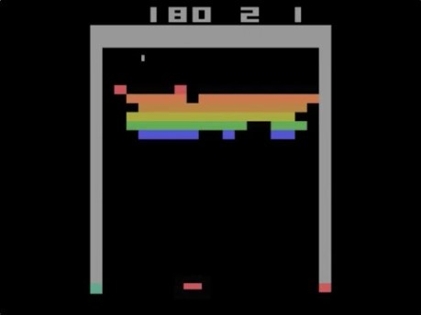
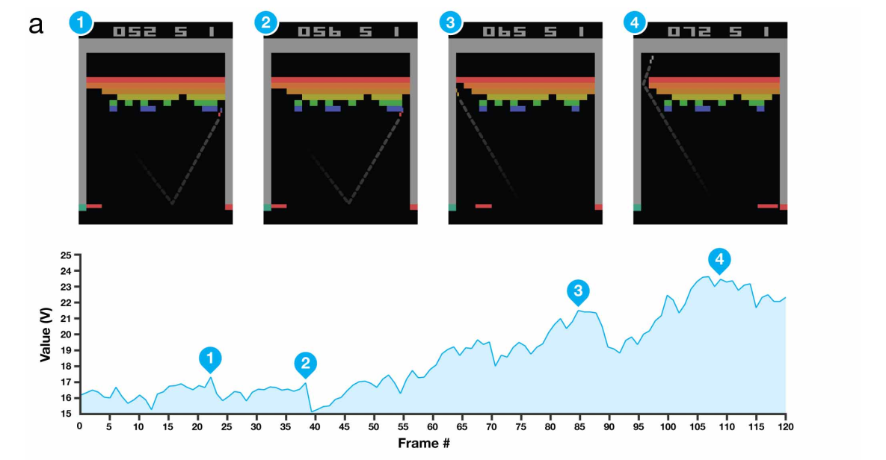
Notes:
Visualization of learned value functions on two games, Breakout and Pong. a, A visualization of the learned value function on the game Breakout. At time points 1 and 2, the state value is predicted to be ,17 and the agent is clearing the bricks at the lowest level. Each of the peaks in the value function curve corresponds to a reward obtained by clearing a brick. At time point 3, the agent is about to break through to the top level of bricks and the value increases to ,21 in anticipation of breaking out and clearing a large set of bricks. At point 4, the value is above 23 and the agent has broken through. After this point, the ball will bounce at the upper part of the bricks clearing many of them by itself. b, A visualization of the learned action-value function on the game Pong. At time point 1, the ball is moving towards the paddle controlled by the agent on the right side of the screen and the values of all actions are around 0.7, reflecting the expected value of this state based on previous experience. At time point 2, the agent starts moving the paddle towards the ball and the value of the ‘up’ action stays high while the value of the ‘down’ action falls to 20.9. This reflects the fact that pressing ‘down’ would lead to the agent losing the ball and incurring a reward of 21. At time point 3, the agent hits the ball by pressing ‘up’ and the expected reward keeps increasing until time point 4, when the ball reaches the left edge of the screen and the value of all actions reflects that the agent is about to receive a reward of 1. Note, the dashed line shows the past trajectory of the ball purely for illustrative purposes (that is, not shown during the game). With permission from Atari Interactive, Inc.
At the beginning the agent is clumsy but it improves with , with the 400 epochs the agent is an expert and the aget is trying to get as many block from the center as it is possible, with 600 epochs the agent has been able to develop a strategy and it is trying to mae a hole in the corner and then pop the ball up there so it bounces around getting many blocks

Slide 14
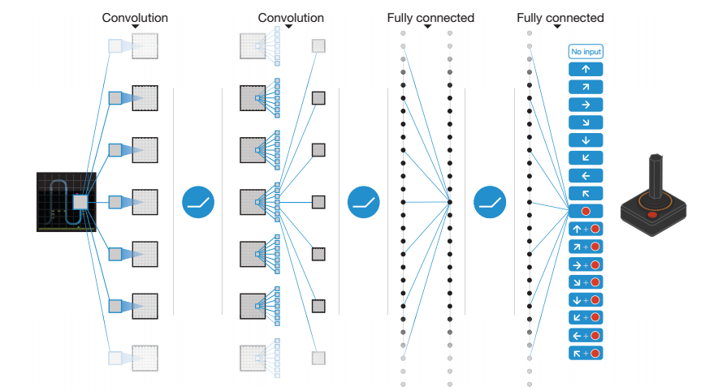
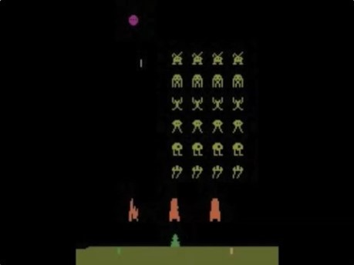
Schematic illustration of the CNN
The input to the neural network consists of an 84 x 84 x 4 image, followed by three convolutional layers and two fully connected layers with a single output for each valid action. Each hidden layer is followed by a rectifier nonlinearity (that is, max(0,x)).
Notes:
Figure 1 | Schematic illustration of the convolutional neural network. The details of the architecture are explained in the Methods. The input to the neural network consists of an 84 3 84 3 4 image produced by the preprocessing map w, followed by three convolutional layers (note: snaking blue line
symbolizes sliding of each filter across input image) and two fully connected layers with a single output for each valid action. Each hidden layer is followed by a rectifier nonlinearity (that is, max 0 ð Þ ,x ).

Slide 15
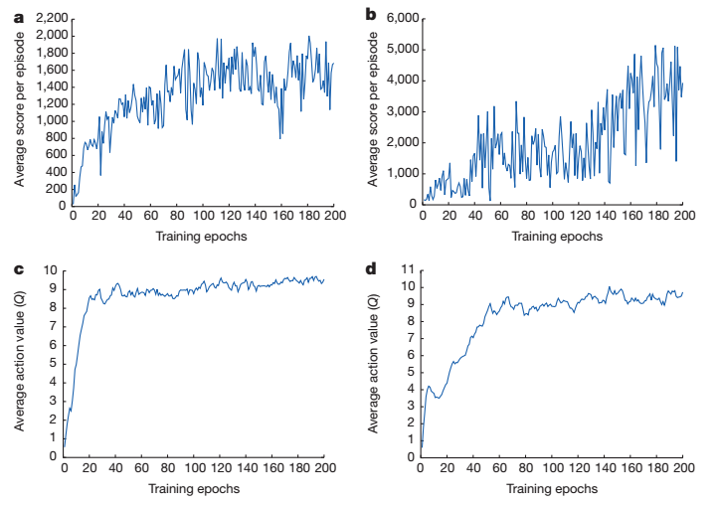
Average score and average predicted action-value.
Space Invaders
Seaquest
Training curves tracking the agent’s.
Each point is the average score achieved per episode after the agent is run with e-greedy policy (e = 0.05) for 520 k frames
Notes:
Figure 2 | Training curves tracking the agent’s average score and average predicted action-value. a, Each point is the average score achieved per episode after the agent is run with e-greedy policy (e 5 0.05) for 520 k frames on Space Invaders. b, Average score achieved per episode for Seaquest. c, Average predicted action-value on a held-out set of states on Space Invaders. Each point on the curve is the average of the action-value Q computed over the held-out set of states. Note that Q-values are scaled due to clipping of rewards (see Methods). d, Average predicted action-value on Seaquest. See Supplementary Discussion for details.

Slide 16
Grandmaster level in StarCraft II using multi-agent reinforcement learning
Notes:
https://www.youtube.com/watch?v=6L448yg0Sm0

Slide 17
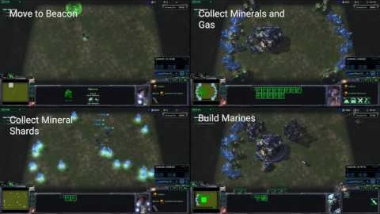

Slide 18
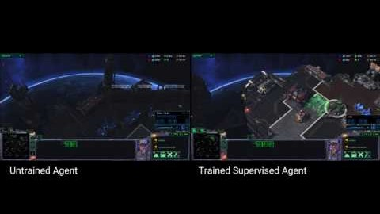

Slide 19
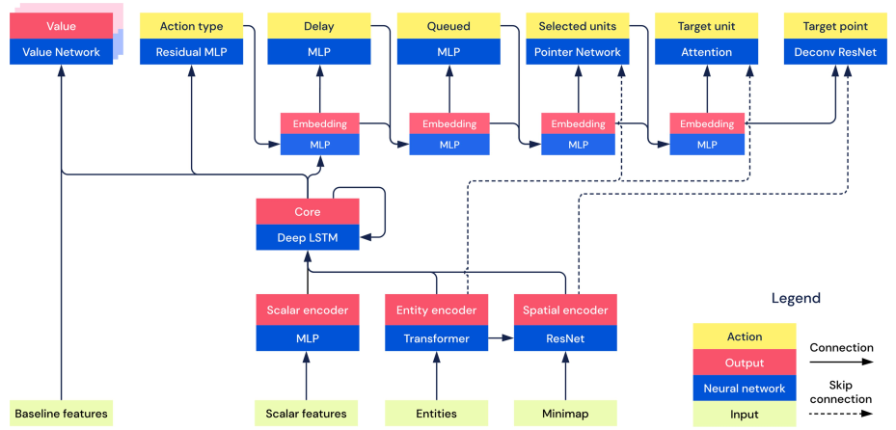
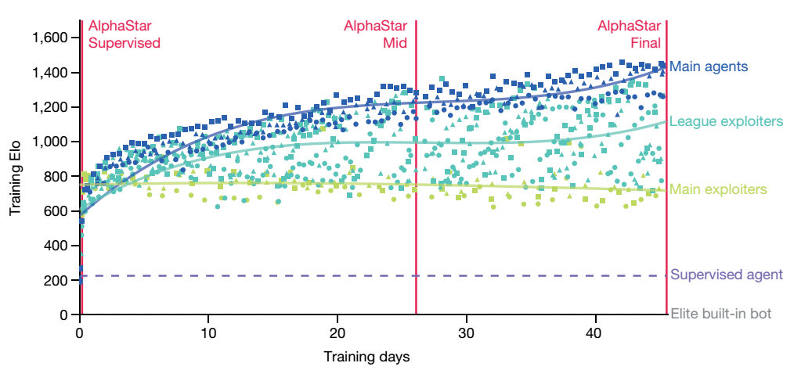
Overview of the architecture of AlphaStar
Notes:
Detail architecture: https://static-content.springer.com/esm/art%3A10.1038%2Fs41586-019-1724-z/MediaObjects/41586_2019_1724_MOESM2_ESM.zip

